Slide 1
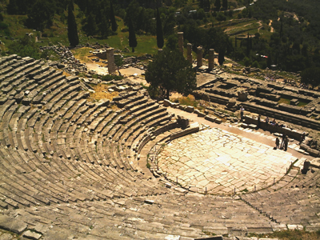
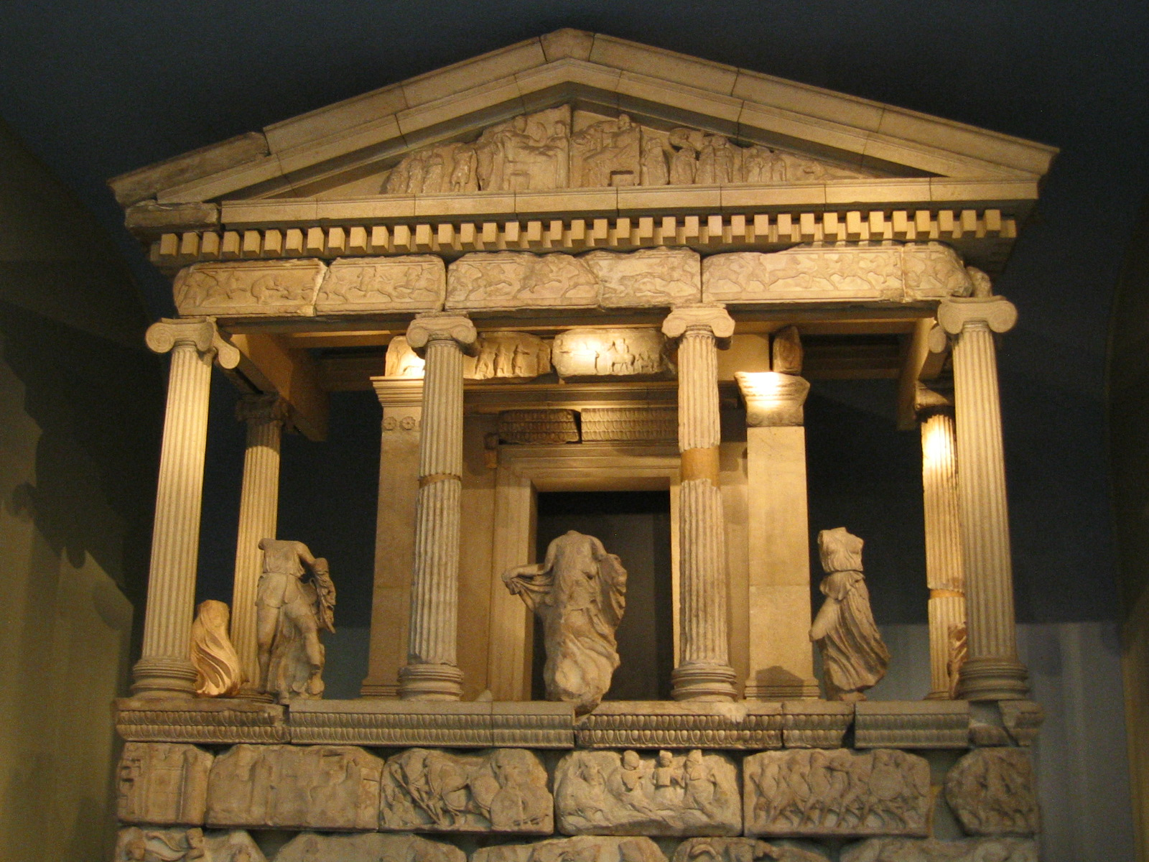
THE ANCENT GREEK CIVILIZATION
By Nora And Karla Sofia

Slide 2
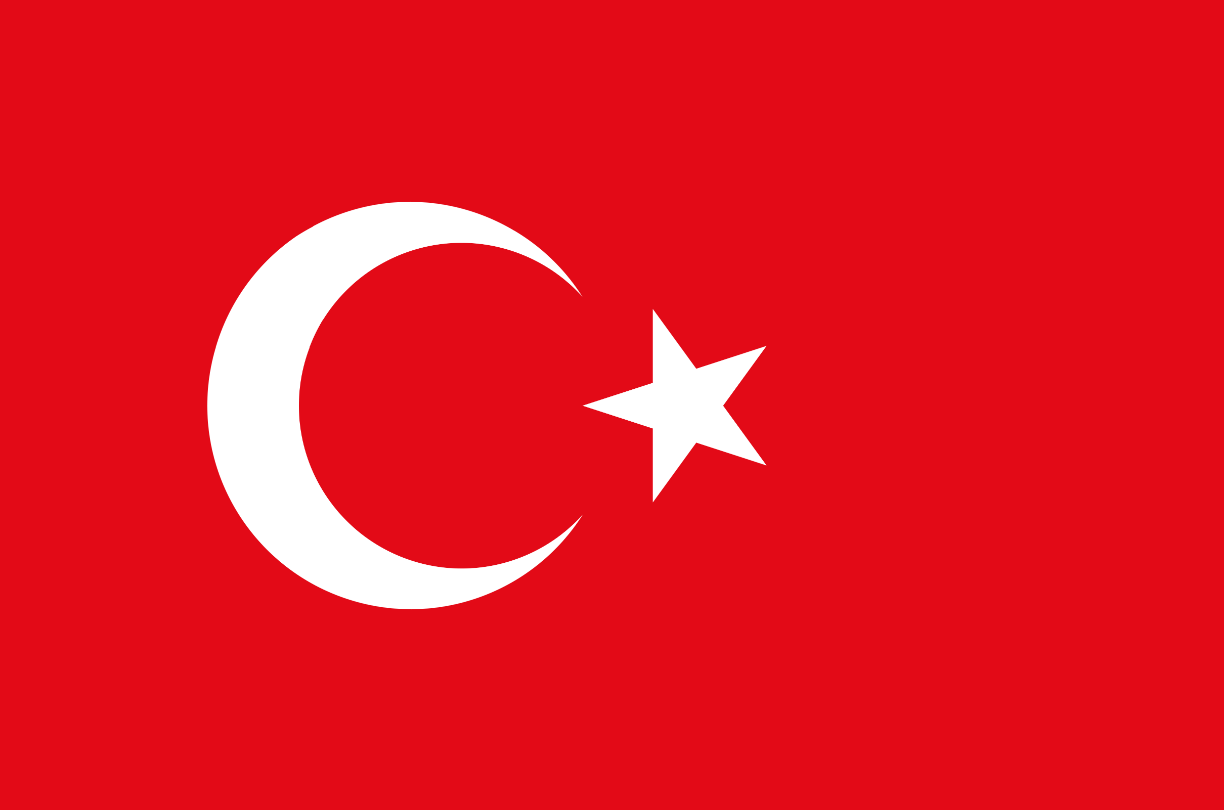
THE START OF ANCIENT GREEK CIVILISATIONS
The earliest Greek civilisations thrived over 4,000 years ago. The ancient Greeks lived in Greece, Turkey, Bulgaria. Their civilisations were split into many different states, each one was ruled in its own way.
They developed new ideas for government, science, philosophy, religion and art.

Slide 3
CLOTHING
Because the weather is hot in Greece, the Ancient Greeks wore light and loose clothing. Clothing and cloth was typically made in the home by the servants and the women of the family.
Men generally wore a tunic called a chiton. The men's tunic could be shorter than the women's, especially if they were working outside. Men also wore a wrap called the himation. Sometimes the himation was worn without a chiton and was draped similar to a Roman toga. When hunting or going to war, the men sometimes wore a cloak called a chlamys The typical garment worn by women in Ancient Greece was a long tunic called the peplos. The peplos was a long piece of cloth that was fastened about the waist with a belt. Part of the peplos was folded down over the belt to make it appear as if it was two pieces of clothing. Sometimes a smaller tunic called a chiton was worn under the peplos. Women sometimes wore a wrap over their peplos called a himation. It could be draped in different ways according to the current fashion.

Slide 4
FOOD
The Greek diet was very healthy. Food in Ancient Greece consisted of grains, wheat, barley, fruit, vegetables, breads, and cake. The Ancient Greeks grew olives, grapes, figs and wheat and kept goats, for milk and cheese. They ate lots of bread, beans and olives. Greeks are master of charcoal-grilled and spit-roasted meats. Souvlaki is still Greece's favourite fast food, both the gyros and skewered meat versions wrapped in pitta bread, with tomato, onion and lashings of tzatziki. At the taverna, local free-range lamb and pork dominate, though kid goat is also a favourite.

Slide 5
ANCIENT GREEK SPORTS
Contests included footraces, the long jump, diskos and javelin throwing, wrestling, the pentathlon (a combination of these five events), boxing, the pankration (a combination of wrestling and boxing), horse races, and chariot races. The Sports Events. The ancient Olympic Games were initially a one-day event until 684 BC, when they were extended to three days. In the 5th century B.C., the Games were extended again to cover five days. The ancient Games included running, long jump, shot put, javelin, boxing, pankration and equestrian events.

Slide 6
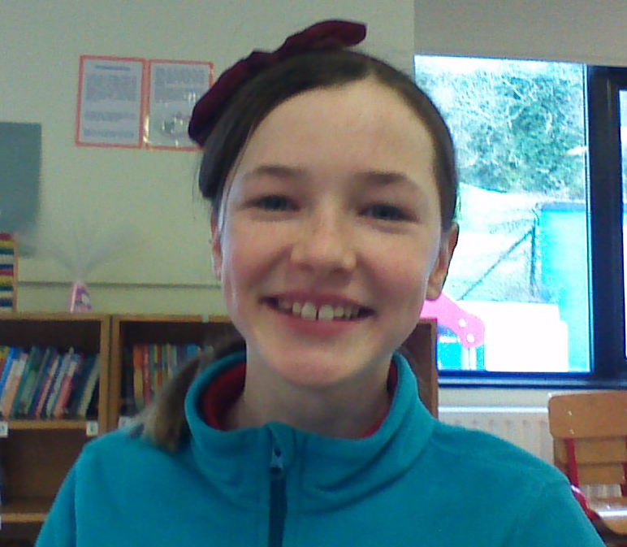
MADE BY…
Nora Nagys
Karla Sofia Byrne

